Slide 1
PEGASUS :Pre-training with
Extracted Gap-sentences for Abstractive Summarization

Slide 2
As you have seen in the title, our goal is to summarize data.
Let’s understand first what is summary?
Lengthy text data, wikipedia pages or some news articles, are usually boring to read and hard to digest completely. Right! Even Things become more difficult when you have to understand all the data from first character to last full stop and also coming up with some meaning out of it.
What if we only have to read one or two sentences to get knowledge about whole lengthy text data instead of reading it fully! cool right!
Summary is that one or two conclusive sentences by which we can get idea and understanding of whole text data.
This summary is also categorized further.
Notes:
What if
-We only need to read 1-2 sentences instead of whole length news.
-Some Speaker’s 2-3 hr long speach in 2-3 minutes
-Instead of listening whole lecture we only have to listen short summary of lecture for better understanding.

Slide 3
Types of Summarization :
Extractive Text Summarization.
It copies informative fragments from the input. That means summary is totally made up of input texts.
Abstractive Text Summarization.
It may generate novel words. That means our summary may have new works which are not there in our text!!!
Example:
Source Text : Ram and Shyam took a taxi to attend the night party in the city. While in the city, Ram collapsed and was rushed to the hospital.
Extractive Summary : Ram and Shyam attend party. Ram rushed hospital.
Source Text : Ram and Shyam took a taxi to attend the night party in the city. While in the city, Ram collapsed and was rushed to the hospital.
Abstractive Summary : Ram was hospitalized after attending a party with Shyam.
Notes:
Abstractive summary have more coherent and meaning.

Slide 4
How machine gonna do “abstractive” summarization !?
MODEL
Input Text
Summary
Here we are sending Sequence as input and getting Sequence as output.
Now This Sequence reminds us of RNN(Recurrent NN) models like LSTM and GRUs which are using encoder-decoder based models.
So, For Text summarization we are gonna use encoder-Decoder based models.
Encoder
Context Vector
Decoder
Input Text
Summary
Sequence-to-Sequence Learning
Notes:
Context vector is basically numerical representation of text which was feed to encoder. Decoder now decode this context vector and produce summary

Slide 5
Transformation from RNN to Transformer
But What if
I have Powerful GPUs and high class computer? models are anyway gonna take input one at a time which will make my resource useless.
-Parallel computing
-Loss of information
-vanishing Gradients (LSTM and GRUs are there but not work well with longer sequences)
Now What if We are allowed to pass whole Sequence at a time instead of giving it on timestamps!
Transformer models came into picture to solve this issue.
Self-Attention with multiple-head
Positional Encoding
Transformer
Encoder
Context Vector
Transformer
Decoder
Input Text
Summary
Notes:
But What if
I have Powerful GPUs and high class computer? models are anyway gonna take input one at a time which will make my resource useless.
Now What if We are allowed to pass whole Sequence at a time instead of giving it on timestamps!
Transformer models came into picture to solve this issue.
-Transformer come up with self-attention mechanism.
the self-attention mechanism allows the inputs to interact with each other (“self”) and find out who they should pay more attention to (“attention”). The outputs are aggregates of these interactions and attention scores.
In RNN we are using Attention with encoder-decoder.
Transformer is totally attention based model.

Slide 6
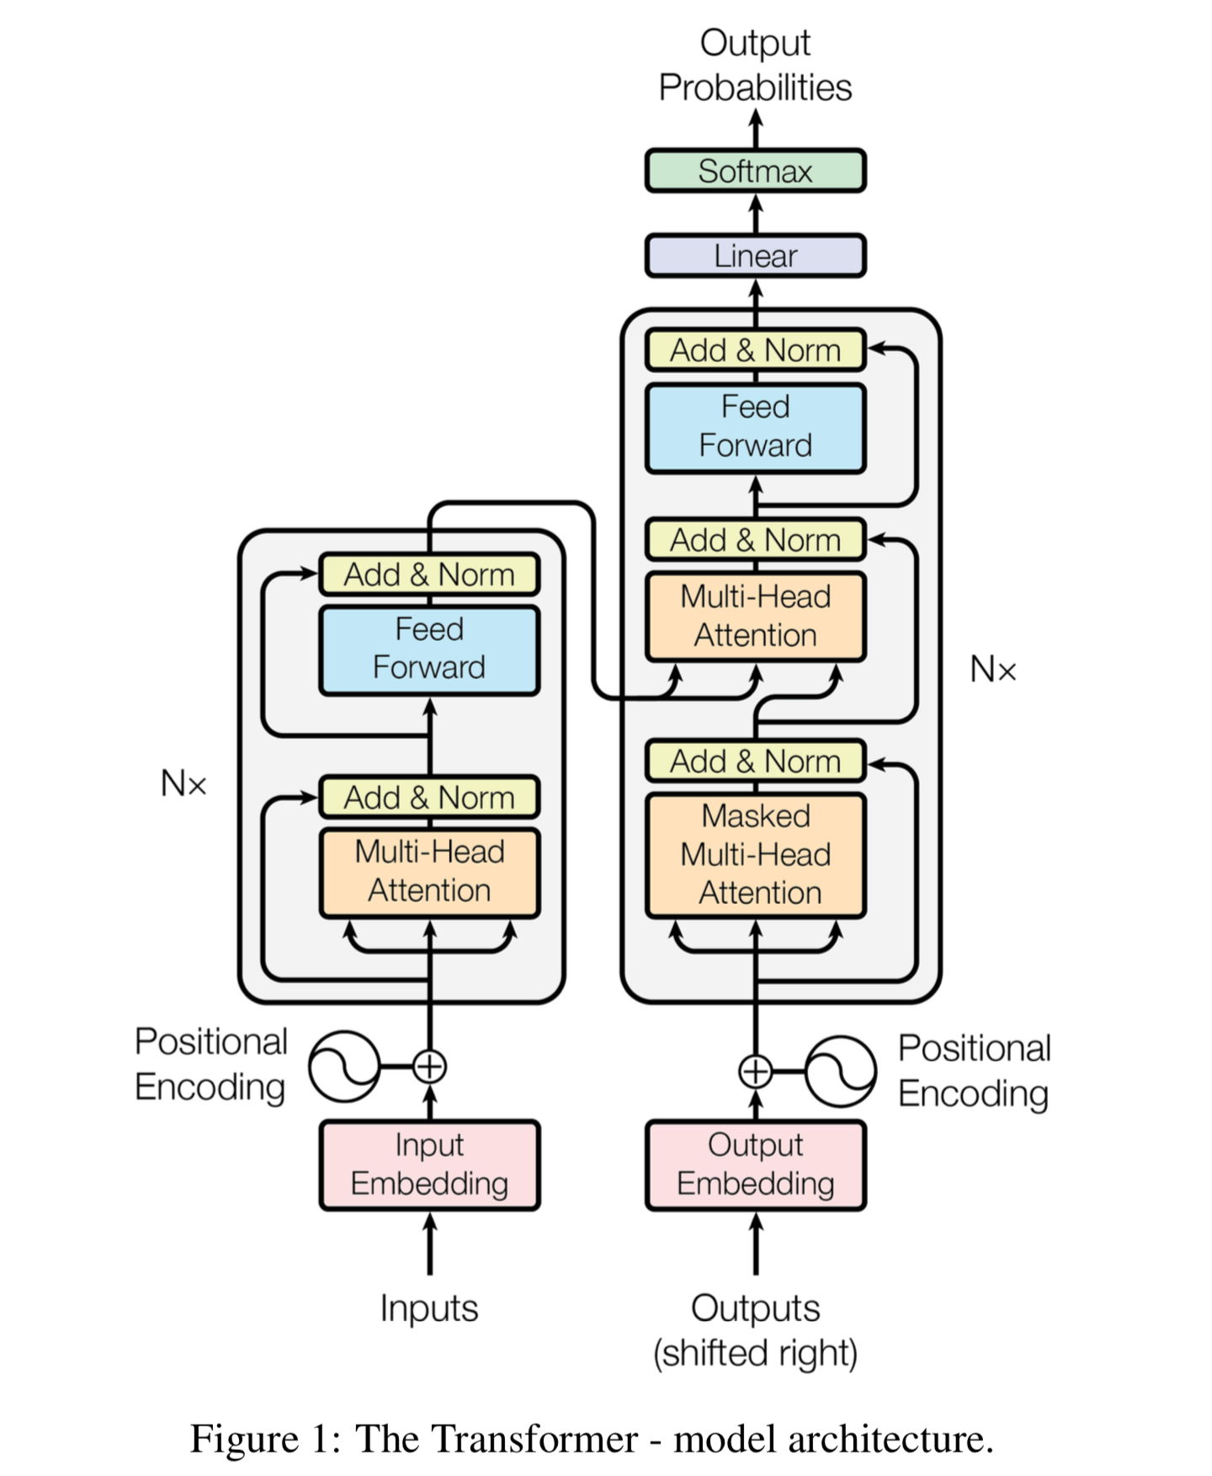
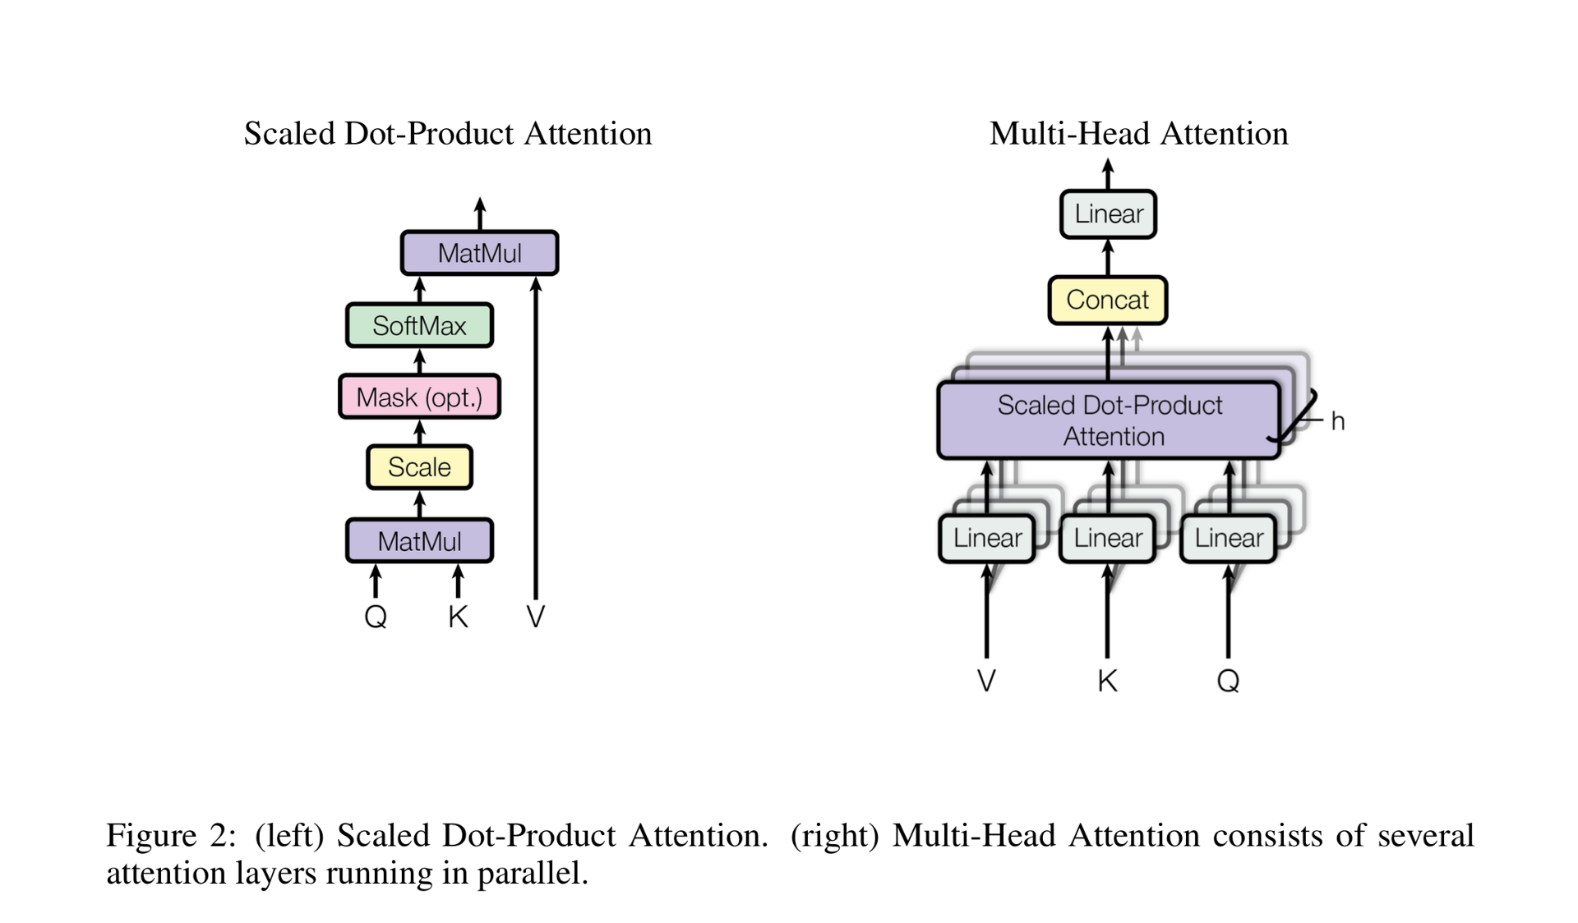
From ‘Attention Is All You Need’ by Vaswani et al.

Slide 7
Transformer Models are Data hungry and need lot of data to train and it’s difficult to train model with doc size in million and to reach SOTA result.
For this google come-up with new idea of Pre-training on large corpus that is of 350M web pages (c4) and 1.5B news articles(HugeNews)!
Now what is Pre-training?
We utilize a model created by someone else to solve a similar problem. Instead of building a model from scratch to solve a similar problem. In layman term, model to recognize car is utilized for truck recognition.
After Pre-training on the model we then perform fine-tuning of the model on the actual data according to our downstream task. Now we don’t need more data to fine-tuning task.
So basically we have two data-set for - Pre-training &
- Fine-Tuning
For pre-Training we required large amount of data as I have mention, data from millions of number of web pages.
Fine-tuning can be done on the small number of data based on our downstream task in our case text summarization.

Slide 8
In PEGASUS they have created 2 pre-training models on 2 different data-set which are C4 and HugeNews.
Pre-Training :
C4 (Colossal and Cleaned version of Common Crawl) : Consists of text from 350M Web-pages(750GB).
HugeNews : 1.5B articles(3.8TB) Collected from news and news-like websites from 2013- 2019.
In PEGASUS they utilized 12 different fine-tuning data-set for text summarization on C4 and HugeNews.
Fine-Tuning :
XSum : PubMed :
CNN/DailyMail : BIG PATENT :
NEWSROOM : WikiHow :
Multi-News : Reddit TIFU :
Gigaword : AESLC :
arXiv : BillSum :

Slide 9
Pre-training models
MASS : masked sequence-to-sequence generation that reconstructs a sentence fragment given the remaining part of the sentence.
UniLM : jointly training on three types of language modeling tasks: unidirectional (left-to-right and right-to-left), bidirectional (word-level mask, with next sentence prediction), and sequence-to-sequence (word-level mask) prediction.
T5 : Pre-trained with randomly corrupted text spans of varying mask ratios and sizes of spans.
BART : BART corrupted text with an arbitrary noising function and learned to reconstruct the original text.
MLM : Mask language modeling. Mask some of the token randomly and try to learn those tokens back.
In contrast to MASS, UniLM, BART, MLM and T5, the proposed PEGASUS masks multiple whole sentences rather than smaller continuous text spans.
Notes:
Now this pre-training can be done in different ways and One such an idea is GAP SENTENCES which is used in PEGASUS model to reach SOTA result.
Hugging face provides us library named “Transformer” for implementation.

Slide 10
Pre-training with Extracted Gap-Sentences, idea is machine mask some of the sentences or words from the text and try to learn those sentences or words from the remaining text. This is self-supervised learning where machine learns from unlabeled data to fill in the blanks for missing pieces. isn't it cool!
Those masked sentences are named as Gap-Sentences which we extract from our text and train model to learn those sentences from remaining text.
Let’s understand it by visuals.
A self-supervised example for PEGASUS during pre-training. The model is trained to output all the masked sentences.From Google Blog on PEGASUS

Slide 11
Up till now, we have Pre-training data-set : C4 and Hugenews
Pre-training method : Gap Sentence Generation (GSG)
DownStream Task : Abstractive Summarization
Question is, what sentences to be selected for masking in pre-training?
PEGASUS has proposed 3 methods to select those mask sentences :
Randomly : Uniformly select m sentences at random.
Lead : Select the first m sentences.
Principal : Select top-m scored sentences according to importance. As a proxy for importance we
compute ROUGE 1- F1 between the sentence and the rest of the document.
We can select principal sentences in 2 ways Independently and Sequentially.
Independently : Select top-m scored sentences for the data according to importance. For importance it compute ROUGE 1-F1 score between sentence and rest of the document.
s_{i} = rouge( x_{i} , D - {x_{i}} ), ∀i.

Slide 12
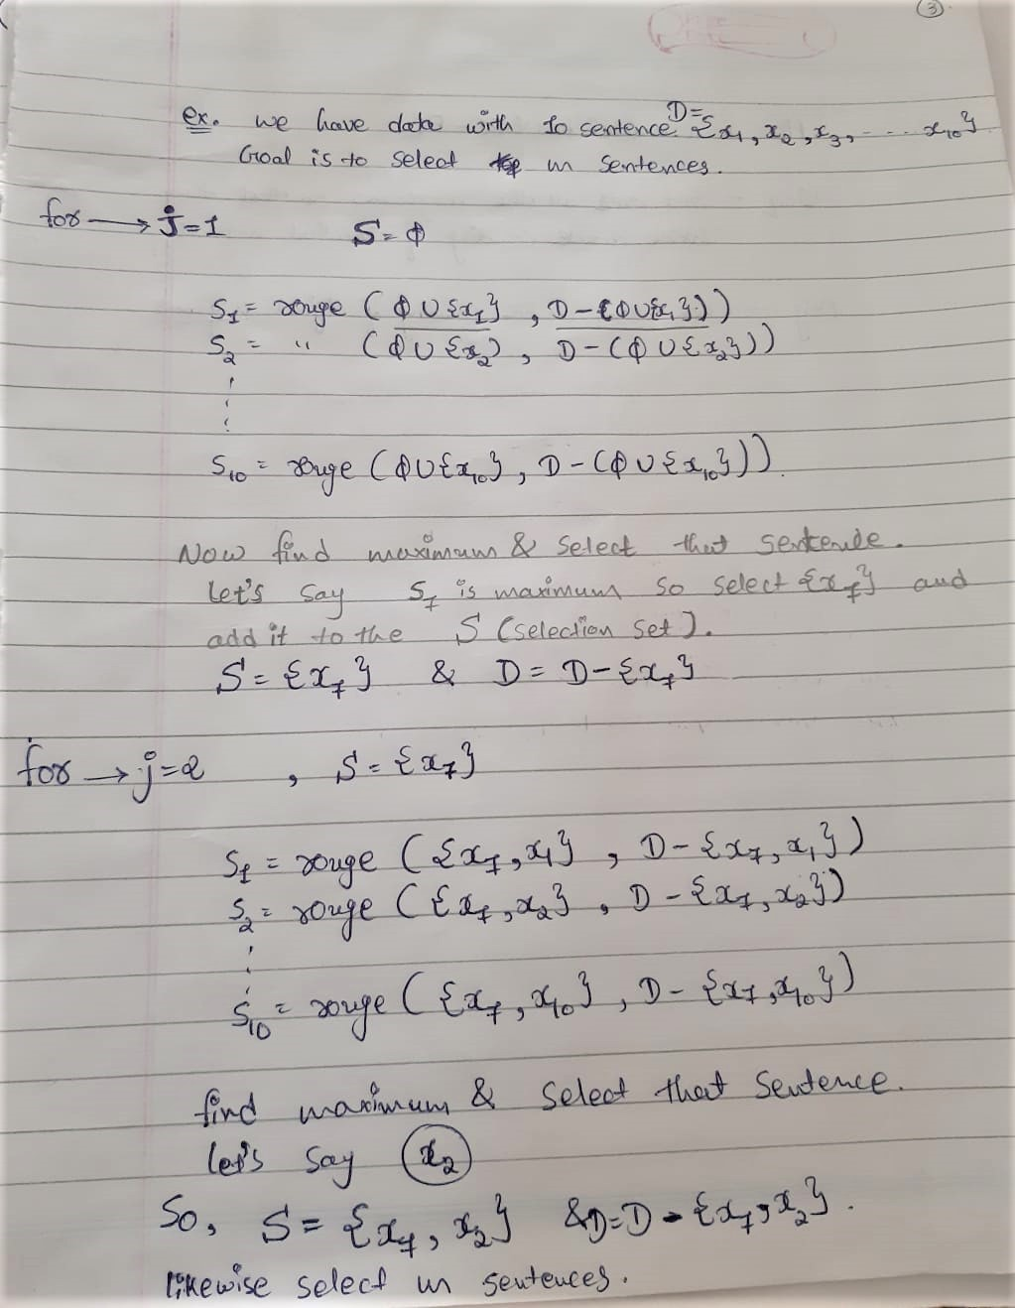
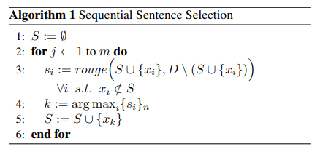
Sequentially : Greedily maximizing the ROUGE 1-F1 between,
Selected sentences S ∪ {x_{i}} and
Remaining sentences D - (S ∪ {x_{i}})
Understand it by Algorithm :
S = Final selection set
s_{i} = ROUGE 1-F1 score for x(i)th sentence

Slide 13

Here is an example of selected GAP-Sentences :
Random Lead Principal

Slide 14
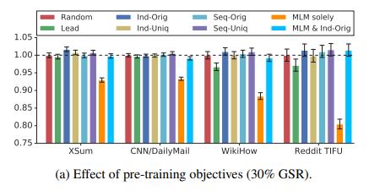
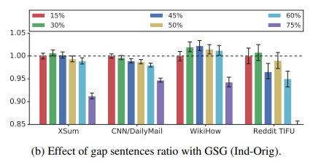
GSR (Gap Sentences Ration) :
Number of selected gap-sentences
GSR =
Total number of sentences in document
From the diagrams we can see that GSR value 15% & 30% works well for all the given data set.

Slide 15
Now, We have everything with us let’s start experiment.
 | Batch Size | Parameters | Data-Set | Number of layers for encoder-decoder(L) | Hidden layer size(H) | Feed-Forward layer size(F) | Number of Self-Attention head(A)
PEGASUS_{BASE} | 256 | 223M | 4 | 12 | 768 | 3072 | 12
PEGASUS_{LARGE} | 8192 | 568M | 12 | 16 | 1024 | 4096 | 16
Vocabulary Option = Unigram with size of 96k
Gradient descent = For optimization, both pre-training and fine-tuning used Adafactor (Shazeer & Stern, 2018) with square root learning rate decay and dropout rate of 0.1.
Notes:
Tokenization methods :
Byte-Pair-Encoding algorithm (BPE)
2.) SentencePiece Unigram algorithm (subword tokenization)ex. Smartest => smart + est ; newer => new + er

Slide 16
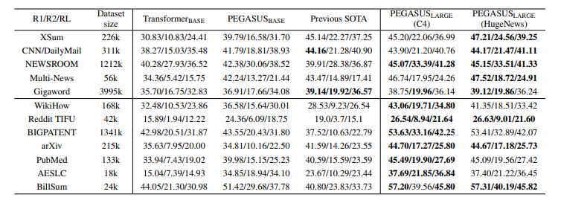
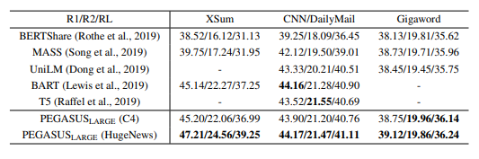
Final Output :

Slide 17
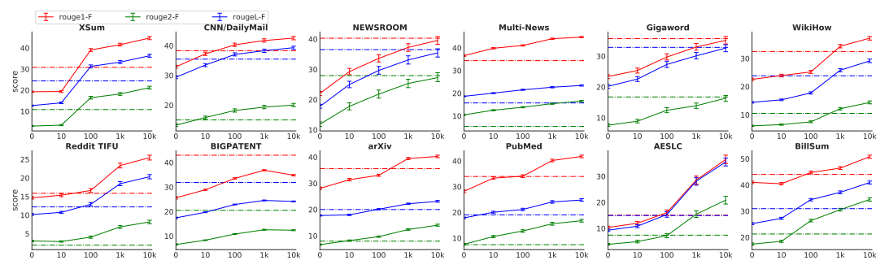
In real world it’s difficult to collect a large number of supervised examples to train or fine-tune a summarization model.
To simulate the low-resource summarization setting, we picked the first 10^{k} (k = 1, 2, 3, 4) training examples from each dataset to fine-tune PEGASUS_{LARGE}
Solid lines PEGASUS_{LARGE}
Dashed lines Transformer_{BASE} models(equivalent in capacity as PEGASUS_{BASE})

Slide 18
Conclusion :
Goal : Abstractive Summarization
Solution : PEGASUS
Pre-training Data-set : C4 and HugeNews
Fine-tuning Data-set : List of 12 Data-sets
DownStream Task : Abstractive Summarization
Pre-training Model : GSG(Gap-Sentence-Generation)
Which Gap-sentences : Principal approach (Independent-Original)
GSR value : 15%
Gradient Descent Algo : Adafactor
Vocabulary Size : Unigram with size of 96k
Parameters : 568M

